Slide 1
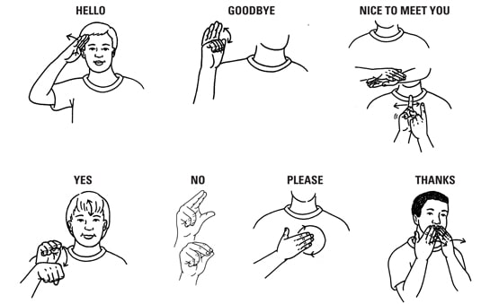
SIGN LANGUAGE RECOGNITION USING COMPUTER VISION
Team Members:
Tejas Chavan, chava106@umn.edu
Aditya Pachpute, pachp006@umn.edu
Rahul Autade, autad001@umn.edu

Slide 2
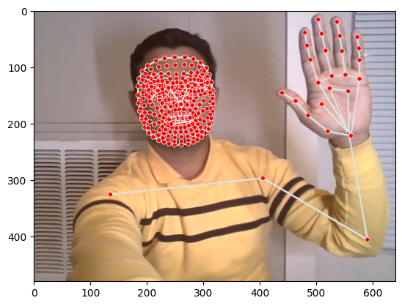

PROJECT MOTIVATION AND GOAL
Motivation:
This work develops sign language recognition through computer vision techniques to bridge communication barriers faced by the deaf and hard-of-hearing community.
Goal:
To recognize American sign language and get a
text and audio output.

Slide 3
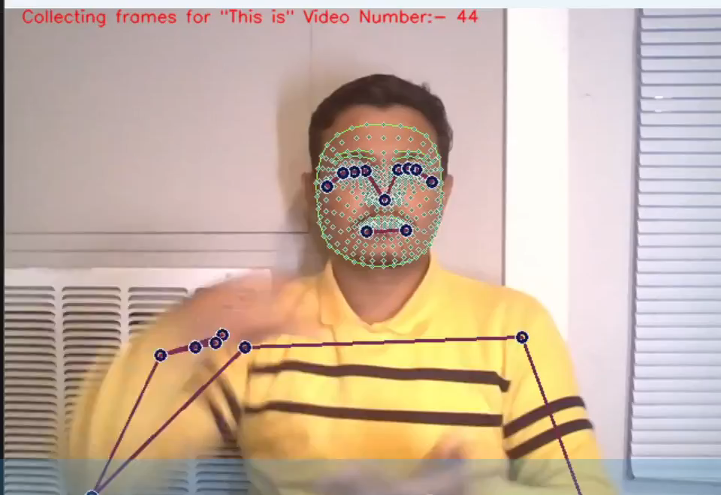
APPROACH:
Detect and Extract Key-points
Setting up Folders
Data Collection
Label into Train, Validation and Test Data

Slide 4
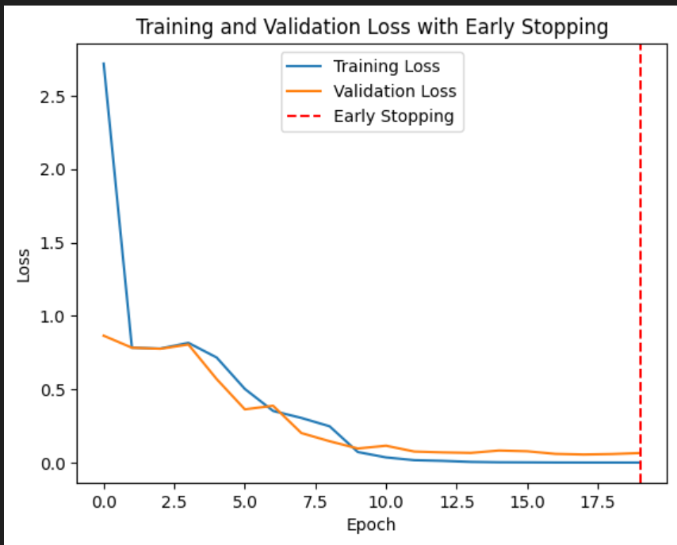
APPROACH:
Layer Number | Layer Type | Number of Neurons.
1 | LSTM | 64 | Relu
2 | LSTM | 128 | Relu
3 | LSTM | 64 | Relu
4 | DENSE | 64 | Relu
5 | DENSE | 32 | Relu
6 | DENSE | 4 | Softmax
Train LSTM Neural Network
Early stopping and Evaluation

Slide 5
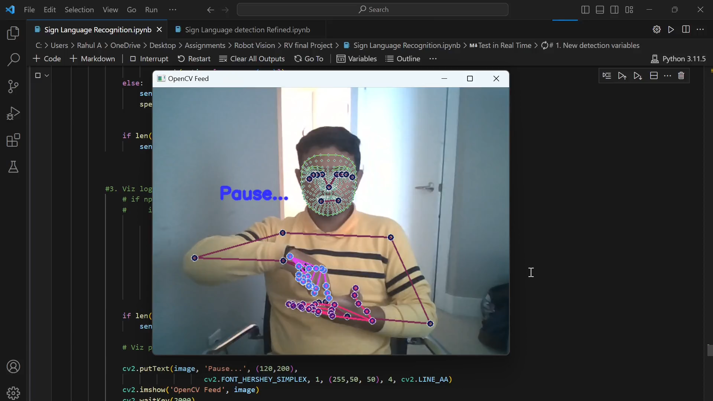
Demo:
Tested on live feed
Text and audio output
Color bar shows confidence level of each prediction
Pause between two subsequence input to avoid gesture confusion.

Slide 6
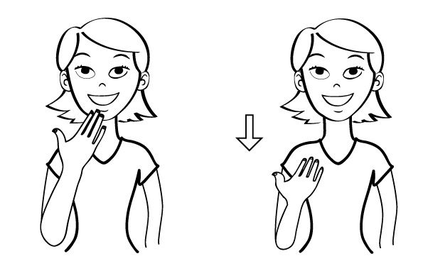
Thank You!
Questions?

